Slide 2
Vocational Courses
Preston | Croxteth | Walton/Witton
Agriculture Animal Care Equine Motorsport Landscape | Equine Animal Care | Animal Care
Most Preston courses are at level one however, there are a small number of entry level courses.
Preston and Walton Hall courses run on a Wednesday 9.30-2.30. Croxteth courses run on a Thursday 9.30-2.30.
This is subject to change.

Slide 3
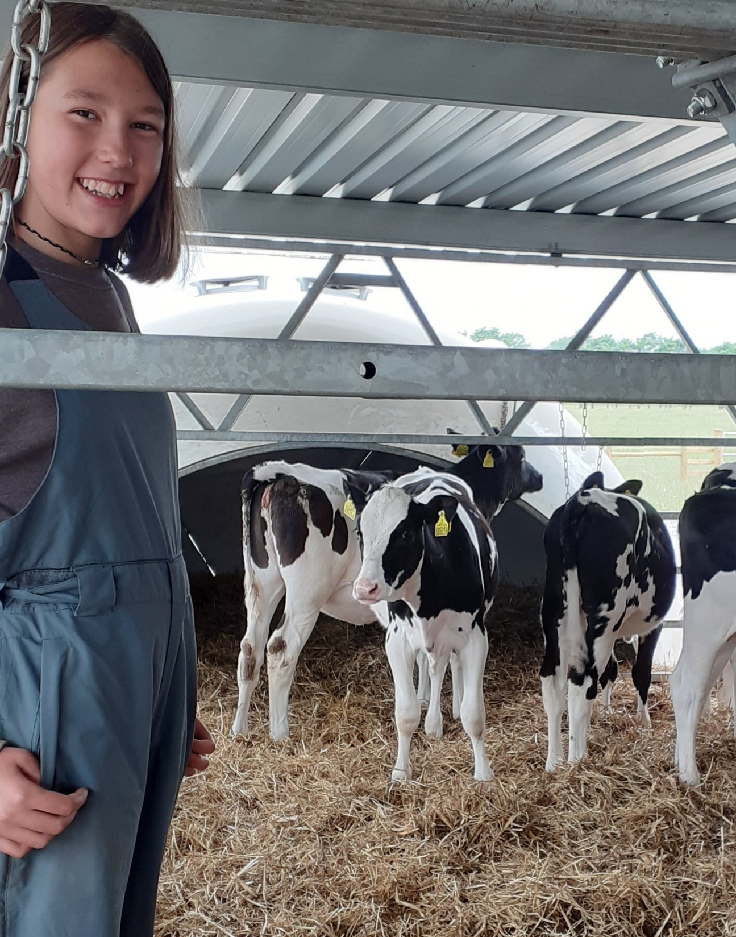
Vocational Course requirements.
Students must be working at least the level of the course and able to manage the practical content of the programme.
Equine is the only course that requires prior experience, others only require an interest and enthusiasm.
All courses are a mixture of theory and practical content.
Group size 10-12 depending on programme.

Slide 4
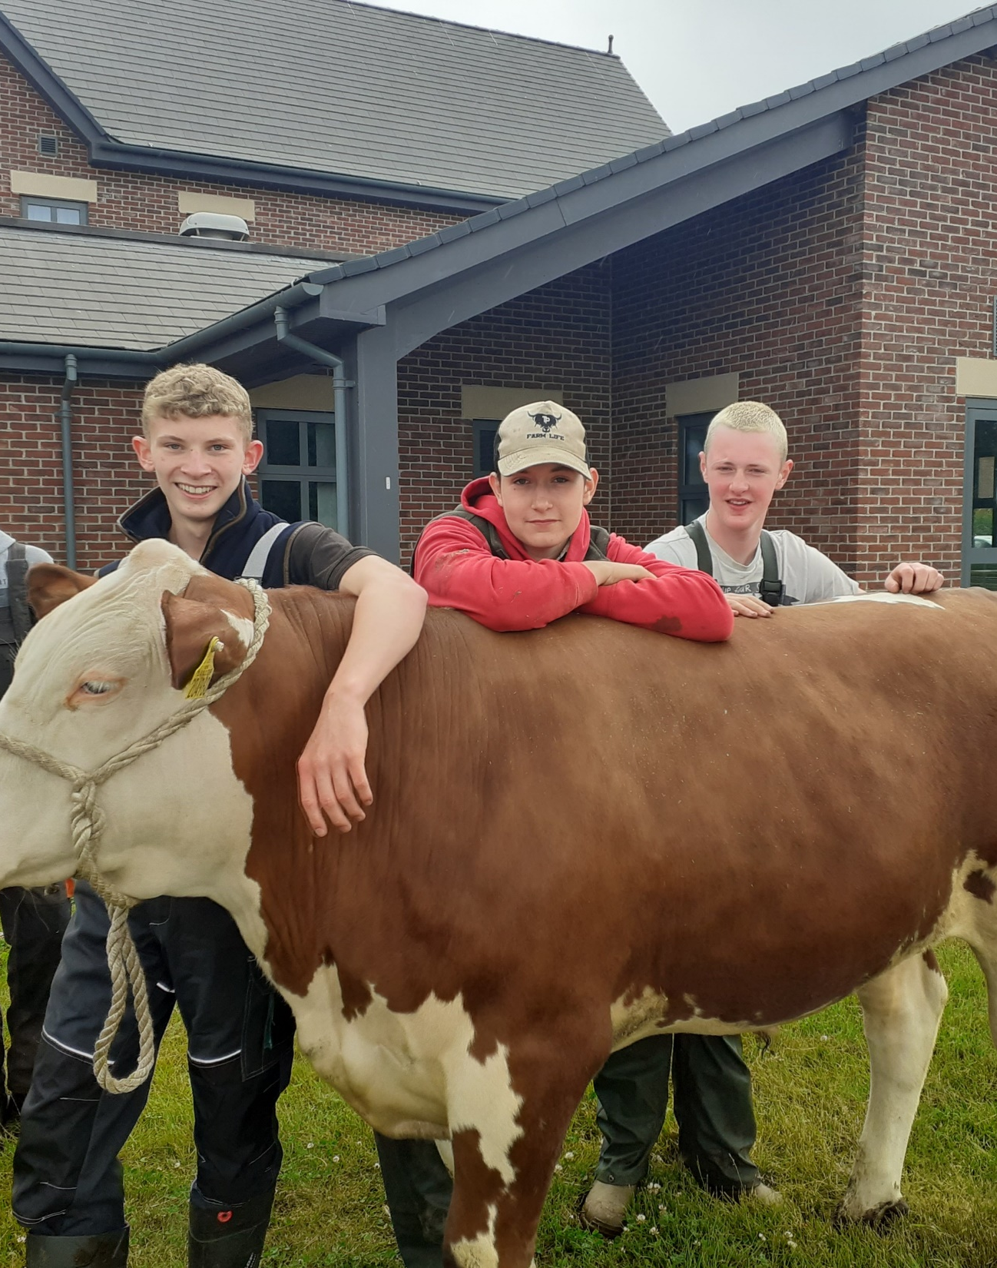
Who Is Eligible?
Year 10 and 11 school students
Home Educated students who are 14 or 15 on or before 31st August of start year.
If students are 16 on or before 31st August then not eligible for programme, must apply for Further Education Course.

Slide 5
Entry Criteria
Home Educated students must be de-registered from school by February half term to qualify for a place that year.
Students with a recent or significant history of mental health issues, including self-harm/ suicidal behaviours/suicide attempts, cannot be managed at College.
College is not a suitable environment for a young person who is experiencing considerable social anxieties that prevent them from engaging and attending their learning
Students must be able to manage their own schedules and behaviour.
Students who have been excluded internally or externally do not qualify for a place.
Applicant should be working at a minimum of Level One (to be reviewed at Interview/Assessment Day).

Slide 6
School Students
On roll with a school.
Vocational one day course.
School must support the application and agree to pay the fees (£1775 per year).
School must provide support where College identify a need.
School students have no access to funding help. Parents can fund if this is the ONLY barrier to their application

Slide 7
Electively Home Educated Students
Students must not be deregistered for the sole purpose of attending Myerscough College.
Students remain legally home educated and so parents are still responsible for providing a full programme of home education around the college course.
Must be formally removed from school and the Local authority roll.
Excluded students who are still on roll with the Local authority DO NOT qualify as an EHE student.
School refusers are still on roll with the local authority DO NOT qualify as EHE.

Slide 8
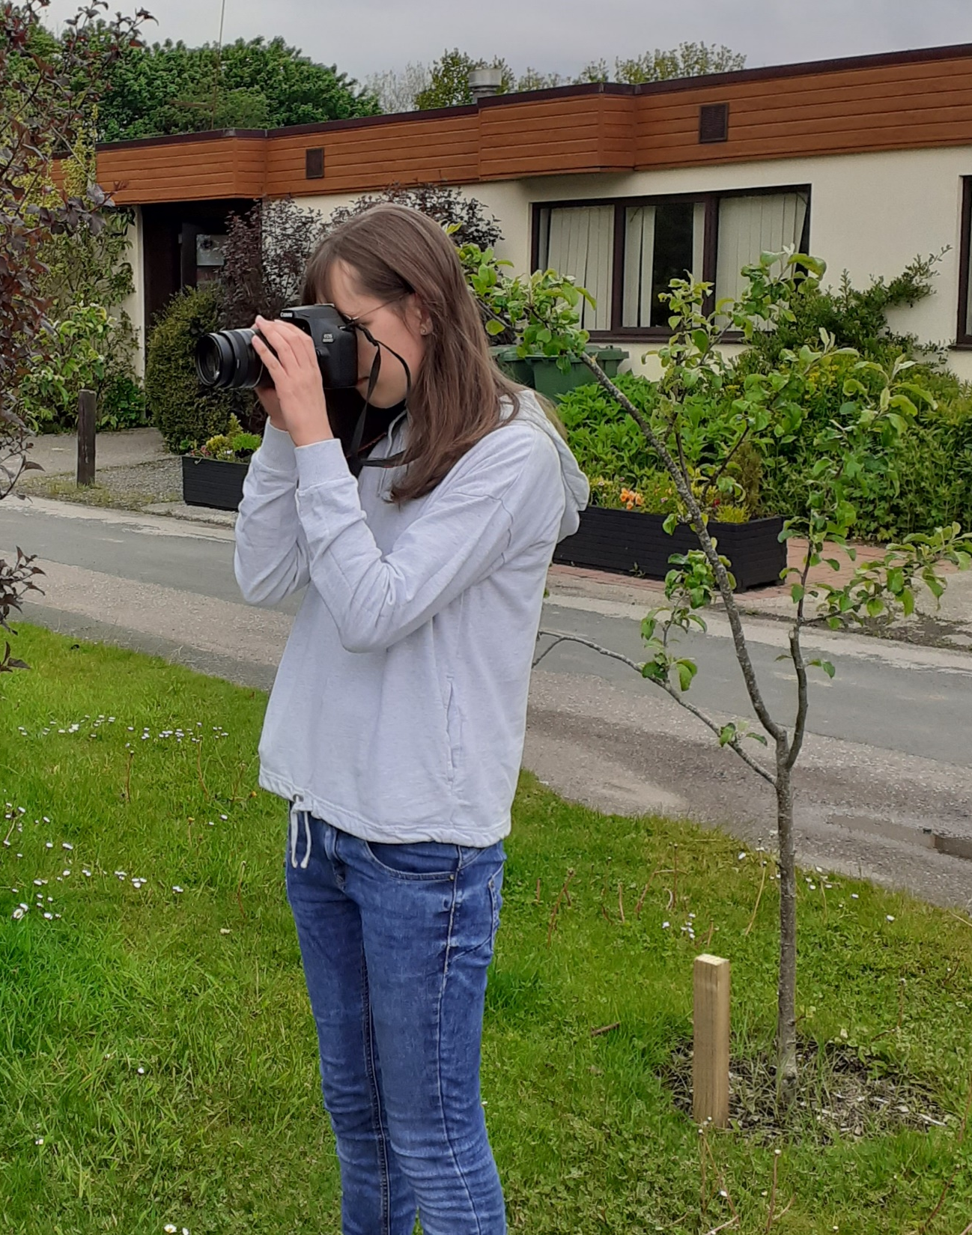
Home Educated Students
Funding can be claimed for tuition fees but not learning support.
Myerscough may reject an application if it is unable to meet student need due to support requirements. Family members are not accepted as support.
Students must be able to maintain an excellent level of attendance.

Slide 9
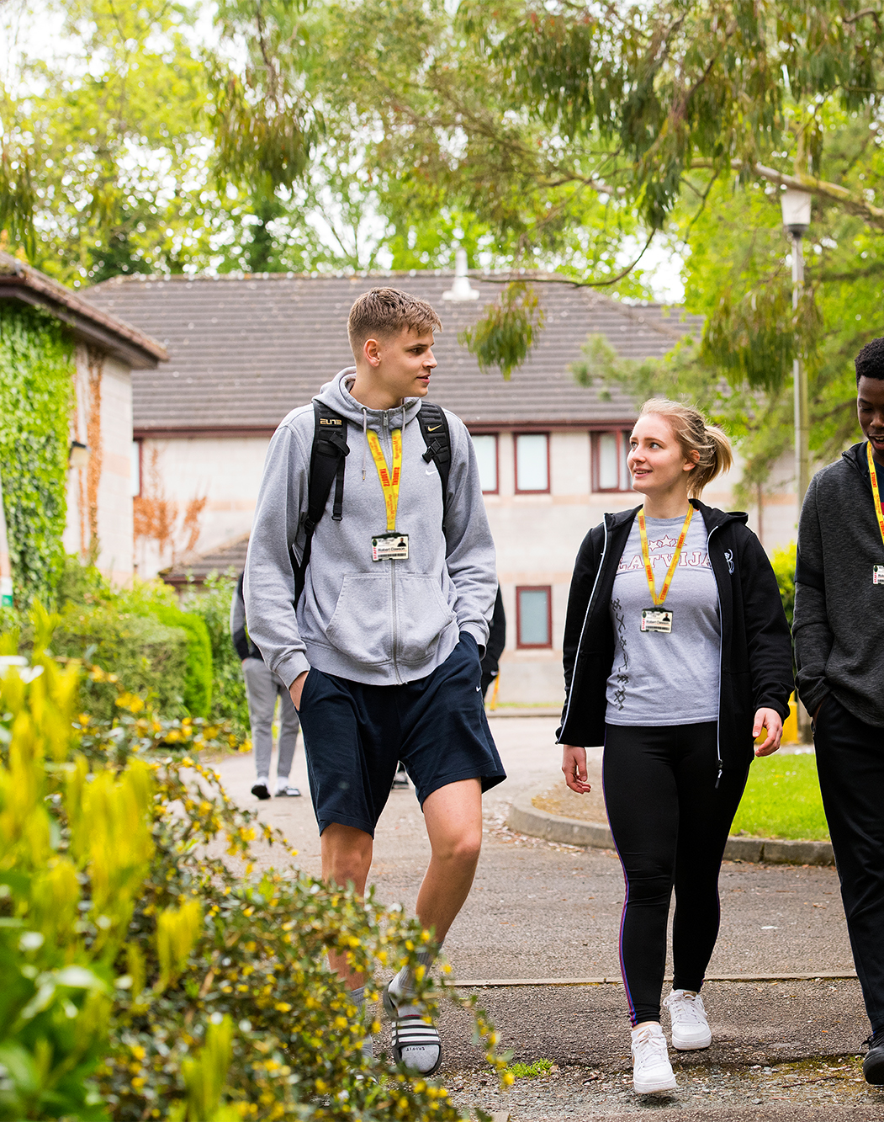
Applications
Online application to be completed. (school students must have permission from school first)
Part B form must be completed.
Previous academic reports must be submitted.
Applications open the 4th of November.
Without any of these elements your application will NOT be processed.

Slide 10
Interviews
Every applicant must attend...
Face to face interviews
Taster sessions
Initial assessments.
Induction days
Failure to attend aspects of the interview will result in your application not being successful

Slide 11
Offers/Rejections
Will be sent via email.
Rejections usually discussed with parents / schools before email sent.
Must go online to student portal to accept offer.

Slide 12
Joining Instructions
Emailed in summer term. Includes dates, times, locations, equipment etc. Link sent to online shop.
Induction day to take place.
Courses start 2nd week in September.
Online enrolment and photograph upload prior to start date.
No holidays to be taken in term time. 6 week probationary period.

Slide 13
Additional information
Students must be transported to and from college. College busses are not accessible for 14-16 students
Students are supervised in the HIVE at lunchtimes to ensure safety of learners.
End of year trips.
End of year prom.

Slide 14
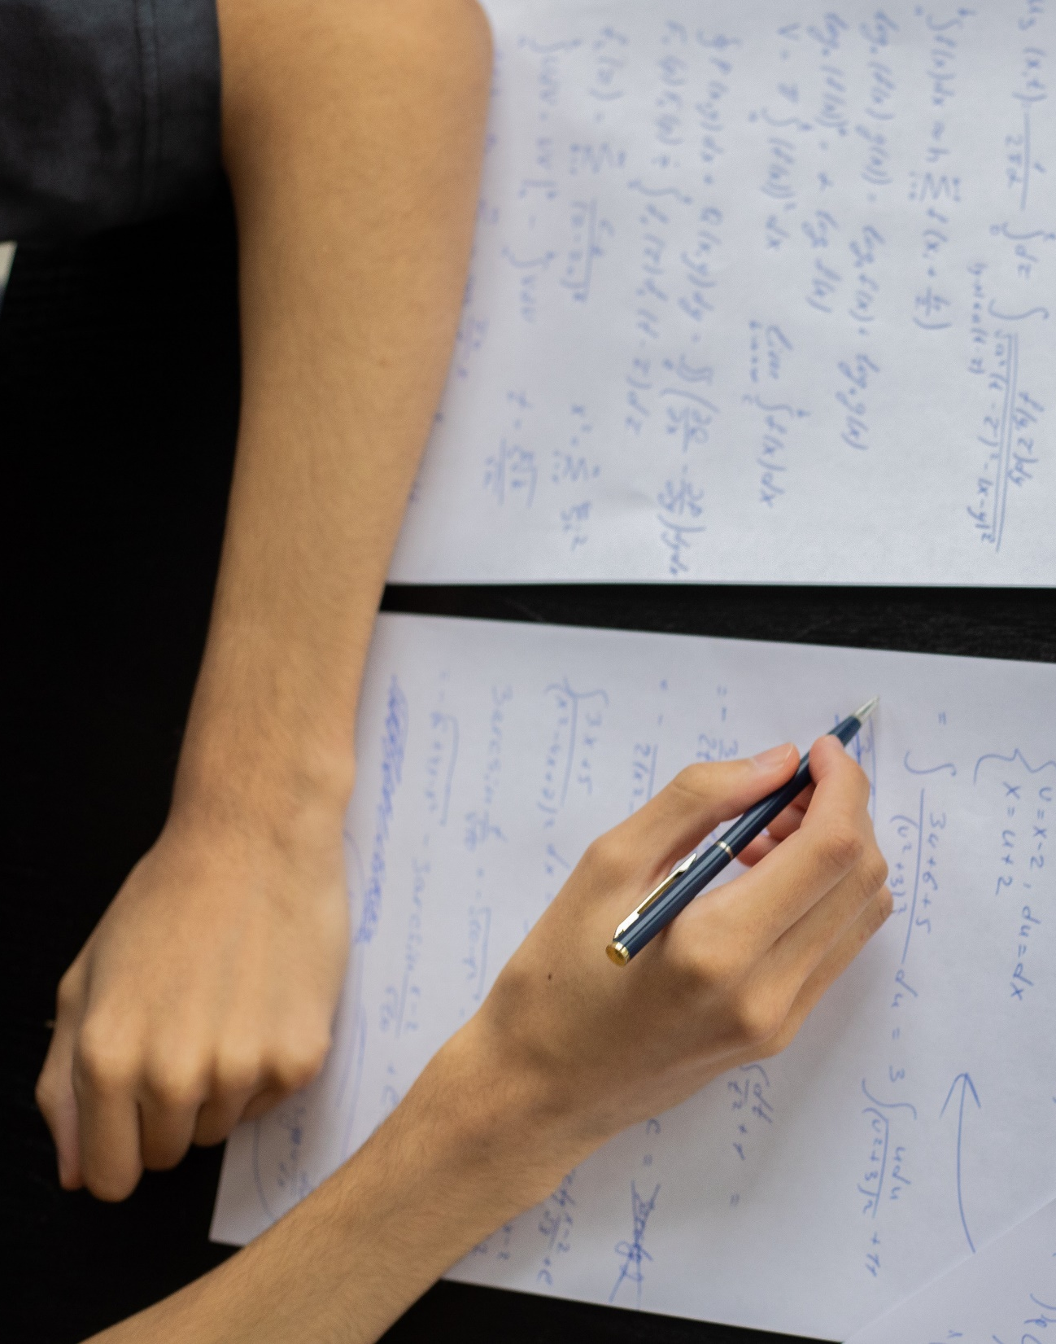
Attendance/ Discipline
Poor attendance cannot be managed due to intensity of courses. If poor health causes issues, then student often better restarting year after.
Zero tolerance on truancy. Drug use or use of vapes/smoking on sight.
High standards of behaviour, maturity and self-management expected.

Slide 15
Contact details
14-16 Co-ordinator
Lucy Smith
Ljsmith@myerscough.ac.uk
Ext 2593
Generic 14-16 email
14to16@myerscough.ac.uk
Transport
Transport@myerscough.ac.uk
Bursary
Bursary@myerscough.ac.uk

